Slide 1
Discipleship
The Biblical Pattern – Week 1

Slide 2
GOD'S MISSION IS TO ESTABLISH A KINGDOM - Isaiah 9:6-7
God's Kingdom will grow.
God's Kingdom will never cease.
God's zeal will ensure this takes place.

Slide 3
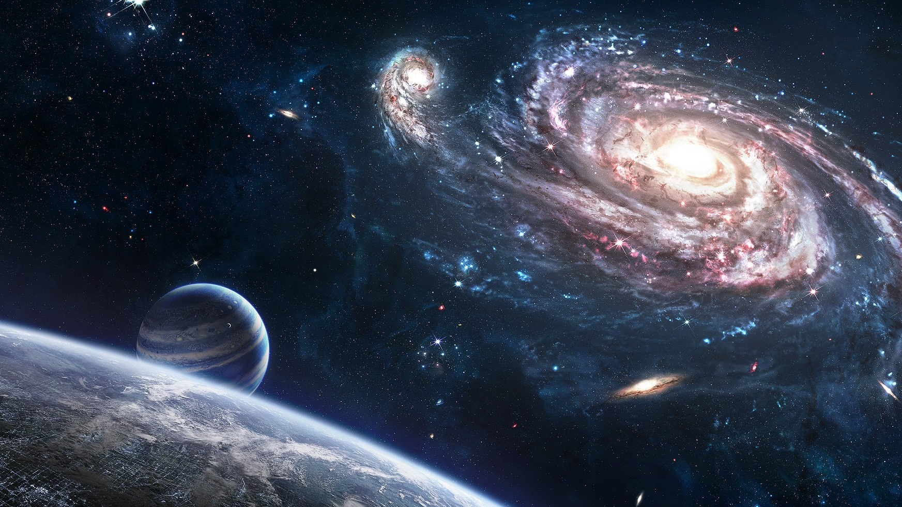
God has a plan for this PLANET and the UNIVERSE.
God has a plan for your LIFE.

Slide 4
The biblical truth can be inferred by comparing Scripture with Scripture.

Slide 5
Job 1:6 Now there was a day when the sons of God came to present themselves before the LORD, and Satan came also among them.
2:1 Again there was a day when the sons of God came to present themselves before the LORD, and Satan came also among them to present himself before the LORD.
Job 38:7 When the morning stars sang together, and all the sons of God shouted for joy?

Slide 6
Genesis 6:2 That the sons of God saw the daughters of men that they were fair; and they took them wives of all which they chose.
6:4 There were giants in the earth in those days; and also after that, when the sons of God came in unto the daughters of men, and they bare children to them, the same became mighty men which were of old, men of renown.

Slide 7
2 Peter 2:4 For if God spared not the angels that sinned, but cast them down to hell, and delivered them into chains of darkness, to be reserved unto judgment;

Slide 8
The Rebellion.
Revelation 12:3-4 And there appeared another wonder in heaven; and behold a great red dragon, having seven heads and ten horns, and seven crowns upon his heads. 4 And his tail drew the third part of the stars of heaven, and did cast them to the earth: and the dragon stood before the woman which was ready to be delivered, for to devour her child as soon as it was born.

Slide 9
The Renovation.
John 1:12 But as many as received him, to them gave he power to become the sons of God, even to them that believe on his name:
Romans 8:14 For as many as are led by the Spirit of God, they are the sons of God.
8:19 For the earnest expectation of the creature waiteth for the manifestation of the sons of God.

Slide 10
The Renovation.
Philippians 2:15 That ye may be blameless and harmless, the sons of God, without rebuke, in the midst of a crooked and perverse nation, among whom ye shine as lights in the world;
1 John 3:1-2 Behold, what manner of love the Father hath bestowed upon us, that we should be called the sons of God: therefore the world knoweth us not, because it knew him not. 2 Beloved, now are we the sons of God, and it doth not yet appear what we shall be: but we know that, when he shall appear, we shall be like him; for we shall see him as he is.

Slide 11
Discipleship is the Heart of God’s Mandate
GOD’S MISSION IS CLEAR
  KEY: Winning souls is not the fulfillment of the commission – it is just the beginning!
GOD’S MISSION IS CONSISTENT THROUGHOUT THE DISPENSATIONS OF BIBLICAL HISTORY.

Slide 12
KEY: The Dispensation of Grace …
Be Fruitful, Multiply and Replenish.

Slide 13
Discipleship is the Heart of God’s Mandate
GOD’S MISSION IS CLEAR
GOD’S MISSION IS CONSISTENT THROUGHOUT THE DISPENSATIONS OF BIBLICAL HISTORY.
GOD'S MISSION ALSO INVOLVES HIS SON THE LORD JESUS CHRIST - Titus 1:2
  There were two purposes for the first coming of Jesus Christ.
GOD’S MISSION IS CONSUMING

Slide 14
Discipleship is the transfer of the reality of spiritual life from one person to another.

Slide 15
Discipleship is the practical process that leads to conformity to the image of Christ.
The mandate.
The meaning.
  Disciple = “Learner.”
The significance.
The lesson.
The Implications: Discipleship is a process that can be measured by four key indicators

Slide 16
The four goals of discipleship.
To establish the believer in the Worship of God.
To establish the believer in the Word of God.
To establish the believer in the Church.
To establish the believer with us in Ministry.

Slide 17
Discipleship is a possess that has both a beginning and an ending.

